Slide 1
Rockbuster Stealth
Data Analysis
Billy Fowler II

Slide 2

Project Overview
Rockbuster Stealth LLC is a movie rental company that used to have stores around the world. Facing stiff competition from streaming services such as Netflix and Amazon Prime, the Rockbuster Stealth management team is planning to use its existing movie licenses to launch an online video rental service in order to stay competitive.

Slide 3

Objectives / Questions
Rating revenue
-Which movies contributed the most/least to revenue gain?
Location Analysis
-Which countries are Rockbuster customers based in?
Rental Duration
-What was the average rental duration for all videos?
Customer
-Where are customers with a high lifetime value based?
Geographic Regions
-Do sales figures vary between geographic regions?

Slide 4
Rockbuster Company Overview
Total customers:
599 customers
Films for rent:
1000 films
Average rental duration:
5 days
Average Rental Cost:
$2.98
Average Replacement cost:
$19.98

Slide 5
Rating Revenue
Most Revenue Generated
- PG-13 rated films
Least Revenue Generated
- G rated films

Slide 6
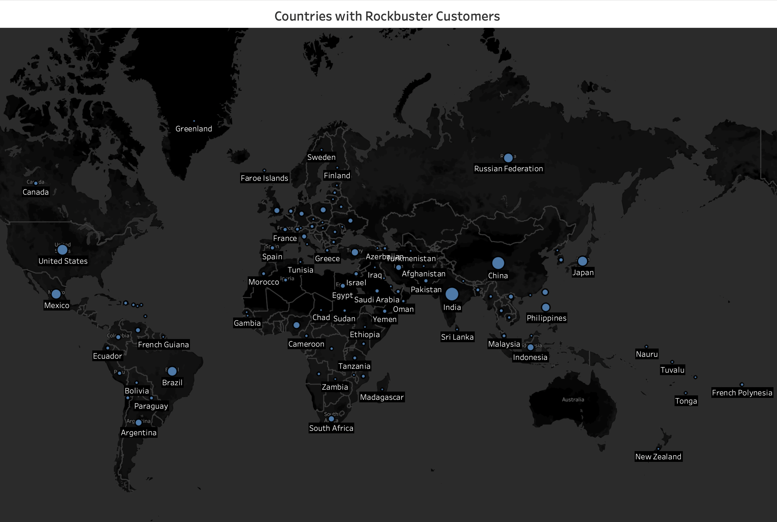

Slide 7
Rental Duration

Slide 8
Top 5 Customer With High Lifetime Value
First Name | Last Name | Country | City | Total amount
Marlene | Welch | Japan | Iwaki | 10.99
Norman | Currier | Indonesia | Cianjur | 10.99
Arlene | Harvey | India | Ambattur | 9.99
Marlene | Welch | Japan | Iwaki | 9.99
Dora | Medina | China | Tianjin | 9.99

Slide 9
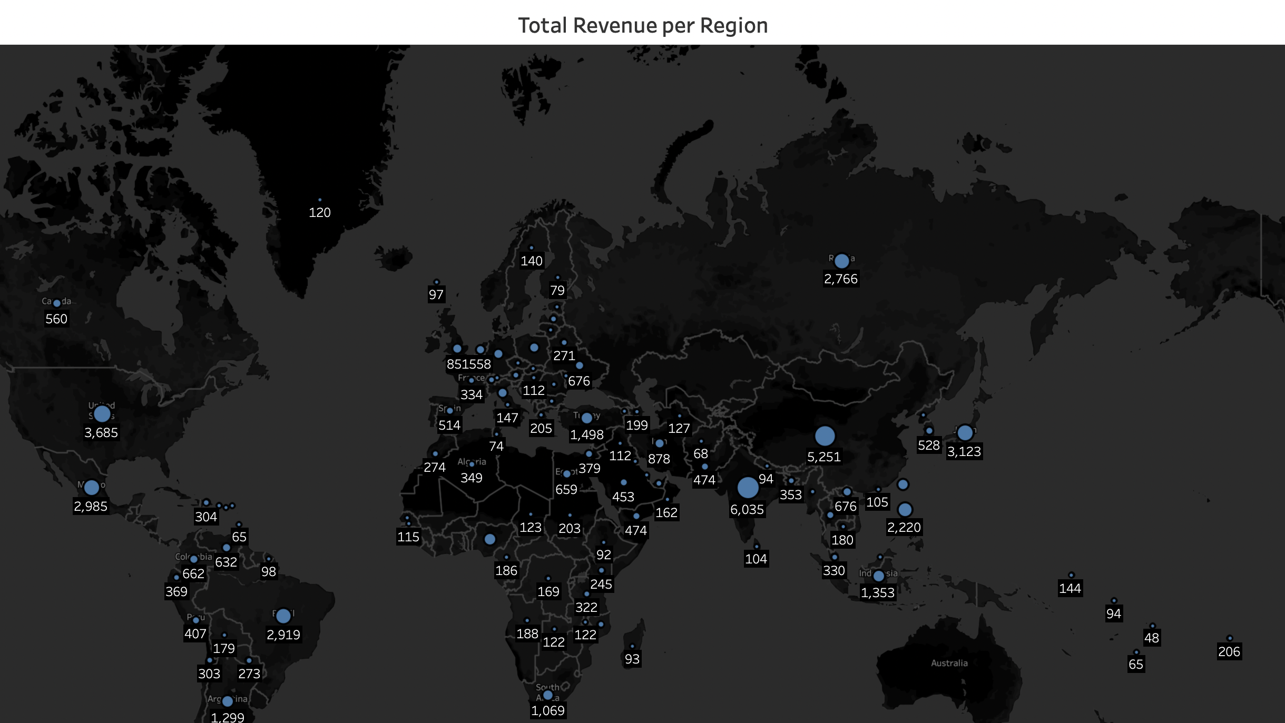
Top 3 Revenue Generating Countries
United States
Japan
Mexico

Slide 10
Recommendations
Through careful data analysis, the data showed PG-13 rated films generating the most revenue globally and G rated films generating the least globally. With now knowing this insight a great recommendation would be to market more of the PG-13 rated films to the customers and or give the customers a wider variety of films with a PG-13 rating.
Another insight that the data gave was that certain genres had longer rental durations than other. In Rockbuster’s inventory, the Thriller genre has the highest average rental duration for all the genres they hold. This tells me that Rockbusters customers enjoying watching movies under this genre more than others. Allocating funds more toward place thriller films in the faced of out customers seems more lucrative.
The top 5 customer based on the amount they pay should be given a loyalty card. A card that gets them better deals then an average customer would receive just because they decided to spend so much money with Rockbuster. A loyalty card that gives them half off all thier purchases for a lifetime. This give our biggest investors more of an incentive to spend more money with our company.

Slide 11

Questions

